Slide 1

Telecom Customer Analysis
User Overview - Engagement- Experience -And- Satisfaction Analysis
This document provides a comprehensive analysis of user behavior, engagement, and experience for a telecom company. It covers key insights from exploratory data analysis, user engagement metrics, and network performance factors that impact the customer experience. The goal is to help the company better understand its customer base and identify areas for optimization to improve overall satisfaction.
NN
NN
by Nitesh Namdev

Slide 2
User Overview Analysis
The first step in understanding the customer base is to conduct an exploratory data analysis on the telecom dataset. This involves identifying key user characteristics, such as the top handsets and manufacturers, as well as analyzing user behavior across various applications and services.
1
Top 10 Handsets
2
Top 3 Handset Manufacturers
Identify the most popular handsets used by customers to understand device preferences and compatibility requirements.
Determine the leading handset manufacturers to focus product and service development efforts.
3
Top 5 Handsets per Manufacturer
4
Recommendations for Marketing
Analyze the top models for each of the top 3 manufacturers to gain deeper insights into customer device choices.
Provide actionable insights to the marketing team based on the user overview analysis to inform targeted campaigns and product offerings.

Slide 3
User Application Behavior
Understanding how customers use various applications on their devices is crucial for tailoring services and marketing efforts. The following analysis explores key metrics related to user application usage.
Application Usage Metrics
Data Cleaning
Exploratory Analysis
Before conducting the analysis, all missing values and outliers in the dataset will be identified and replaced with the mean of the corresponding column to ensure data integrity.
The analysis will explore various statistical measures, visualizations, and correlations to uncover insights about user application behavior and preferences.
For each user, the following metrics will be aggregated for each application: number of sessions, session duration, total download and upload data, and total data volume.

Slide 4
Descriptive Statistics
The first step in the exploratory data analysis is to describe the relevant variables and their associated data types, as well as analyze the basic metrics and their importance for the overall objective.
Variable Description
Basic Metrics
Provide a detailed description of all relevant variables and their associated data types to establish a clear understanding of the dataset.
Analyze the mean, median, and other relevant statistical measures for the dataset, and interpret their importance in the context of the global objective.
Dispersion Parameters
Graphical Analysis
Compute dispersion parameters, such as standard deviation and variance, for each quantitative variable to gain insights into the distribution and spread of the data.
Utilize appropriate plotting options for each variable to visually explore the data and uncover any patterns or trends.

Slide 5
Bivariate and Multivariate Analysis
Exploring the relationships between variables is crucial for gaining a deeper understanding of the dataset and identifying potential insights.
Bivariate Analysis
Correlation Analysis
Examine the relationship between each application and the total download and upload data using appropriate statistical methods, such as correlation analysis or regression, to uncover any significant associations.
Compute a correlation matrix for the key variables, such as social media data, Google data, email data, YouTube data, Netflix data, gaming data, and other data, to explore the strength and direction of the relationships between them.
1
2
3
User Segmentation
Segment the users into the top five decile classes based on the total duration for all sessions, and compute the total data (download and upload) per decile class to identify any patterns or trends in user behavior.

Slide 6

User Engagement Analysis for Telecom Brands
Telecom brands, as the data providers of all online activities, must focus on meeting user requirements and creating an engaging user experience to succeed in the market. This document outlines a comprehensive analysis of user engagement metrics, including session frequency, duration, and total traffic, to help telecom brands optimize their services and target their most engaged customers.
NN

Slide 7
User Engagement Analysis
Tracking user engagement is crucial for understanding customer behavior and identifying opportunities to improve the overall user experience. By analyzing metrics such as session frequency, duration, and total traffic, the telecom company can gain valuable insights into user engagement levels and tailor its services accordingly.
Session Frequency
Total Session Traffic
Analyze the number of sessions per customer to identify highly engaged users and potential churn risks.
Examine the total download and upload data during user sessions to gauge the overall level of engagement and resource utilization.
1
2
3
Session Duration
Evaluate the length of user sessions to understand content consumption patterns and identify areas for improvement.

Slide 8
Identifying Top Engaged Customers
1
Aggregate Metrics per Customer
2
Normalize and Cluster Customers
3
Analyze Cluster Metrics
Aggregate the engagement metrics per customer ID (MSISDN) and report the top 10 customers per engagement metric.
Normalize each engagement metric and run a k-means (k=3) clustering to classify customers into three groups of engagement.
Compute the minimum, maximum, average, and total non-normalized metrics for each cluster. Interpret the results visually with accompanying text explaining the findings.

Slide 9
Optimizing Engagement Clusters
Determine Optimal Clusters
Interpret Cluster Findings
Visualize Cluster Metrics
Using the k-means clustering algorithm, group users into k engagement clusters based on the engagement metrics.
Interpret the findings from the k-means clustering. Provide 4-5 key insights about the different engagement clusters and how they can inform the telecom brand's strategy.
Compute and visualize the minimum, maximum, average, and total non-normalized metrics for each engagement cluster. Explain how these metrics can be used to better understand and target the different customer segments.
What is the optimized value of k (use the elbow method for this)?

Slide 10
Leveraging User Engagement Insights
Optimize Network Resources
Enhance User Experience
Increase Business Success
By understanding the different engagement clusters, telecom brands can concentrate network resources for different groups of customers based on their engagement scores.
Insights from the user engagement analysis can help telecom brands improve the quality of service and create more engaging experiences for their customers across mobile platforms.
The success of a telecom brand's business is ultimately determined by the user engagement and activity of its customers. By leveraging these insights, brands can drive higher user engagement and activity, leading to greater business success.

Slide 11
Recommendations
1
Implement Engagement Tracking
2
Personalize User Experiences
Leverage the insights from the user engagement analysis to personalize the user experience and tailor services to the specific needs of different customer segments.
Establish a robust system to continuously track and analyze user engagement metrics across all mobile applications and platforms.
3
Optimize Network Resources
4
Continuously Improve
Allocate network resources strategically based on the engagement levels of different customer clusters, ensuring the most engaged users receive the best quality of service.
Regularly review and refine the user engagement analysis, incorporating new data and emerging trends to ensure the telecom brand remains responsive to the evolving needs of its customers.

Slide 12
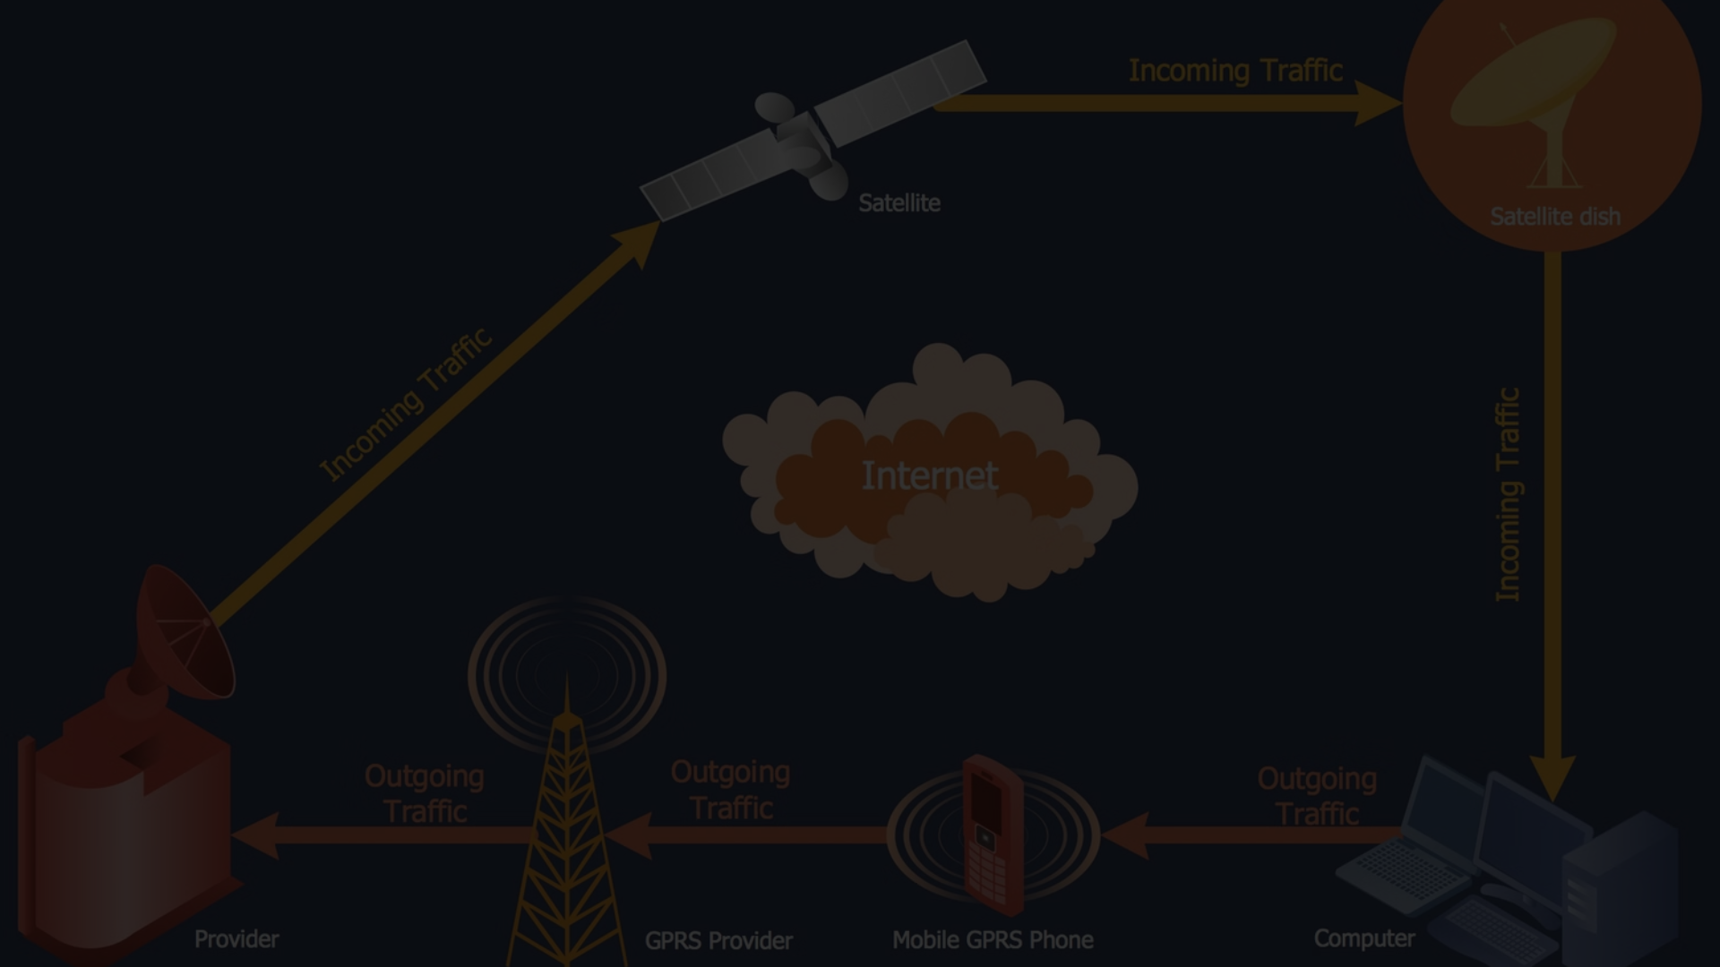
Experience Analytics in the Telecommunication Industry
The telecommunication industry has undergone a significant transformation in the last decade, with mobile devices becoming a vital part of everyday life. To stay competitive, telecom vendors must focus on understanding their customers' needs, perceptions, and experiences. By tracking and evaluating customer experience, organizations can optimize their products and services to meet evolving user expectations. This presentation will explore key network parameters and device characteristics that impact the user experience in the telecom industry.
NN

Slide 13
Experience Analytics
Analyzing the user experience is crucial for the telecom industry, as it directly impacts customer satisfaction and loyalty. By focusing on network performance metrics and device characteristics, the company can identify areas for improvement and optimize its services to meet evolving customer needs.
Network Performance Metrics
Device Characteristics
User Segmentation
Examine the impact of customer device types on network performance and user experience to ensure compatibility and optimize service delivery.
Leverage k-means clustering to group users based on their experience metrics and provide tailored solutions to address the needs of each segment.
Analyze key network parameters such as TCP retransmission, Round Trip Time (RTT), and throughput to understand the quality of service experienced by customers.

Slide 14
Importance of User Experience
The success of the mobile industry is largely dependent on its consumers. Therefore, the vendors must focus on their target audience - what are the needs and requirements of their consumers and how they feel and perceive their products. Tracking and evaluating customers' experience can help organizations optimize their products and services so that it meet evolving user expectations, needs, and acceptance.
In the telecommunication industry, the user experience is related, most of the time, to network parameter performances or the customers' device characteristics. Key metrics to analyze include:
TCP retransmission
Round Trip Time (RTT)
Throughput
Handset type

Slide 15
Aggregating User Experience Metrics
To conduct a deep user experience analysis, we need to aggregate the following information per customer, treating any missing or outlier data by replacing with the mean or mode:
1
Average TCP Retransmission
2
Average RTT
TCP retransmission is a key indicator of network performance and can impact the overall user experience.
Round Trip Time (RTT) measures the time it takes for a data packet to travel from the user's device to the server and back. Higher RTT can lead to lag and frustration.
3
Handset Type
4
Average Throughput
The type of device a user has can affect their experience, so it's important to analyze performance by handset.
Throughput, or the amount of data transferred per unit of time, is a key indicator of network speed and quality.

Slide 16
Top, Bottom, and Most Frequent Metrics
To further understand the user experience, we should compute and list the 10 top, bottom, and most frequent values for the following metrics:
TCP Retransmission
Round Trip Time (RTT)
Throughput
Identifying the highest and lowest TCP retransmission values can reveal network trouble spots and areas for improvement.
Analyzing the top, bottom, and most common RTT values provides insights into network latency and its impact on the user experience.
Understanding the distribution of throughput values helps identify performance issues and opportunities to enhance network speed and capacity.

Slide 17
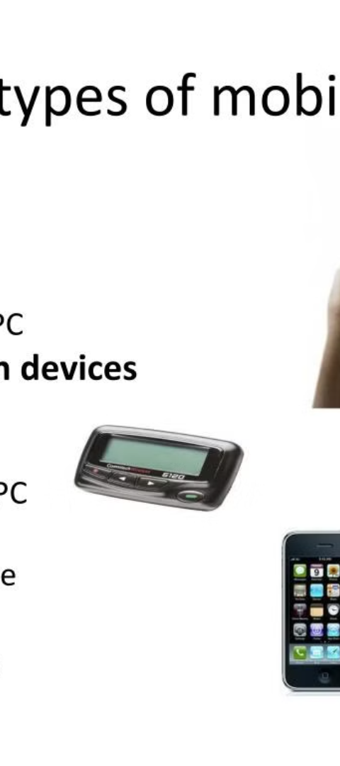
Throughput and TCP Retransmission by Handset Type
To further analyze the user experience, we should compute and report:
1
Distribution of Average Throughput per Handset Type
2
Average TCP Retransmission per Handset Type
Examining the throughput performance across different handset types can reveal device-specific network optimization opportunities.
Understanding the TCP retransmission patterns for each handset type can help identify network issues that may be device-dependent.

Slide 18
User Segmentation by Experience
Using the experience metrics gathered, we can perform a k-means clustering (with k=3) to segment users into groups based on their overall experience. This will allow us to better understand the different user profiles and tailor our products and services accordingly.
Cluster 3
Cluster 1
Users in this cluster are likely facing significant network and device-related challenges, resulting in a poor overall experience that requires immediate attention.
Users in this cluster likely have a positive overall experience, with good network performance and device compatibility.
1
2
3
Cluster 2
Users in this cluster may be experiencing some issues, such as higher TCP retransmission, longer RTT, or suboptimal throughput, leading to a more frustrating experience.

Slide 19
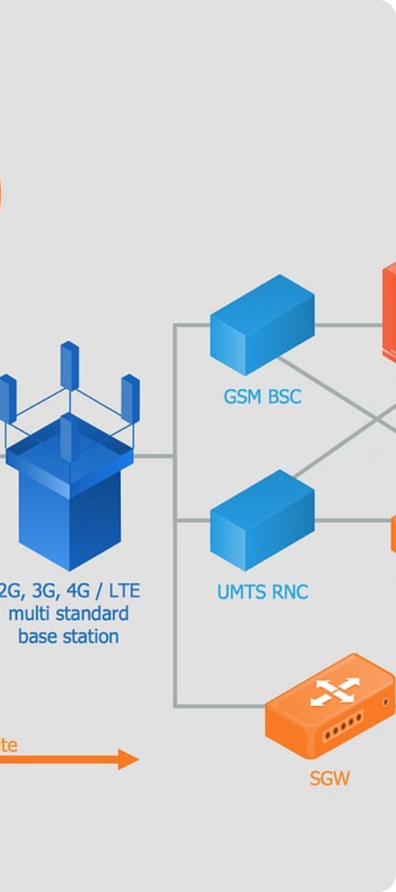
Leveraging User Experience Insights
By analyzing the key network parameters and device characteristics that impact user experience, telecom organizations can make informed decisions to optimize their products and services. This can include:
Network Optimization
Device Compatibility
Identifying and addressing network performance issues to improve TCP retransmission, RTT, and throughput.
Ensuring seamless compatibility and performance across a wide range of handset types to provide a consistent user experience.
Targeted Offerings
Developing tailored products and services to meet the specific needs of different user segments, based on their experience profiles.

Slide 20
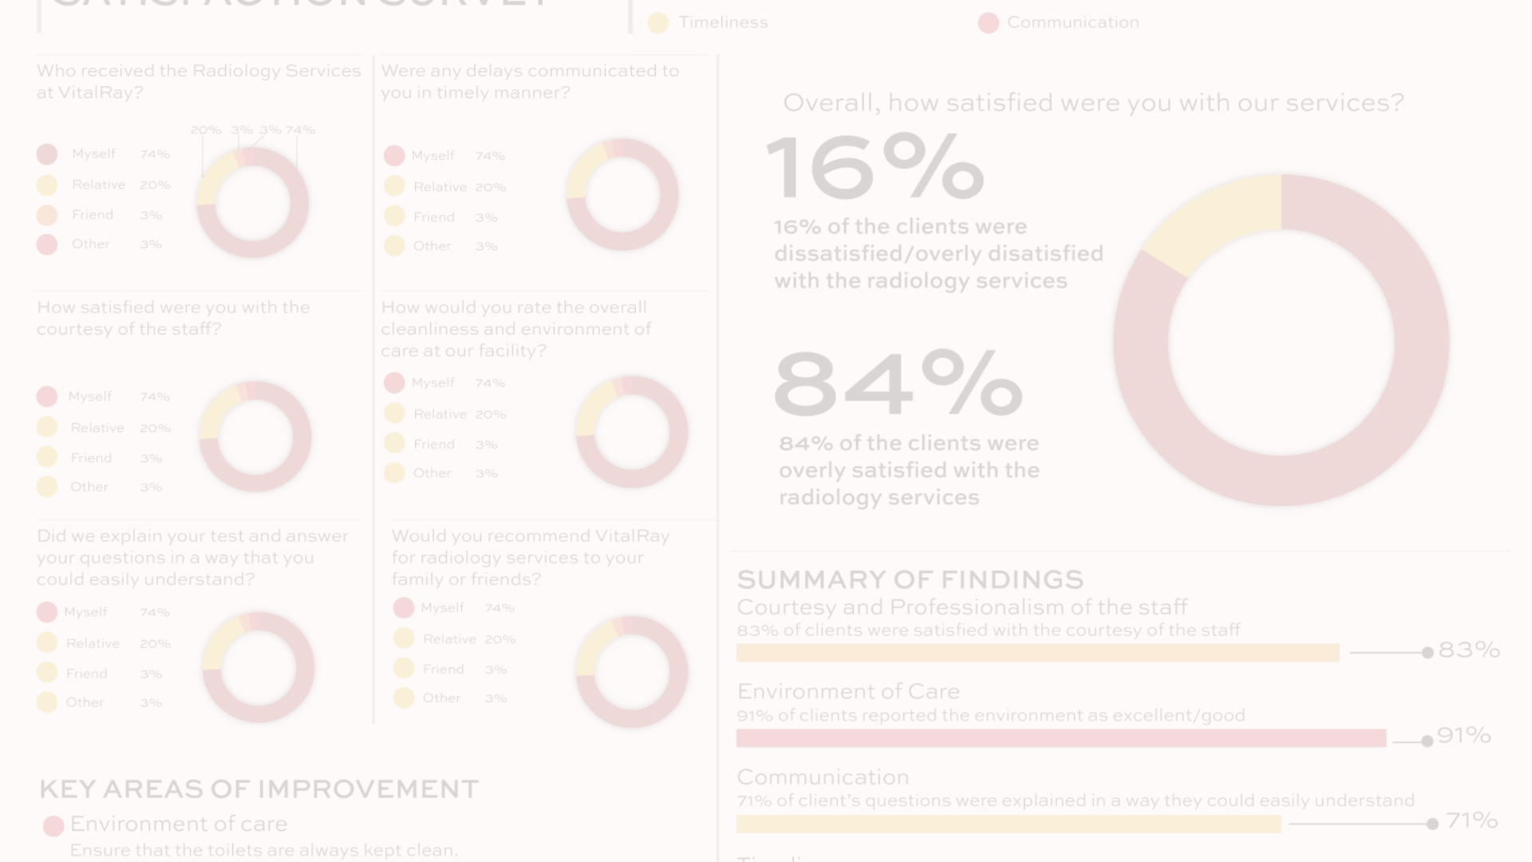
Satisfaction Analysis
This presentation will analyze customer satisfaction based on user engagement and experience. We will assign engagement and experience scores to each user, calculate their overall satisfaction, and build a regression model to predict satisfaction. We will also cluster users based on their engagement and experience scores, and analyze the average satisfaction and experience per cluster.

Slide 21
Satisfaction Analysis
Ultimately, the goal of the telecom company is to ensure a high level of customer satisfaction. By combining the insights from the user engagement and experience analyses, the company can develop a comprehensive understanding of customer satisfaction and identify areas for improvement.
Engagement Score
Experience Score
Calculate the engagement score for each user based on the Euclidean distance from the least engaged cluster, considering metrics such as session frequency, duration, and total traffic.
Determine the experience score for each user based on the Euclidean distance from the worst experience cluster, considering network performance metrics and device characteristics.
Satisfaction Score
Predictive Modeling
Combine the engagement and experience scores to derive the overall satisfaction score for each user, and identify the top 10 most satisfied customers.
Develop a regression model to predict the satisfaction score of customers based on the engagement and experience metrics, and monitor the model's performance over time.

Slide 22
Engagement Score
To calculate the engagement score for each user, we will use the Euclidean distance between the user's data point and the less engaged cluster from the initial clustering analysis. The Euclidean distance measures how far the user is from the less engaged group, which represents their level of engagement.
1
Step 1
2
Step 2
3
Step 3
Perform the initial clustering analysis to identify the less engaged cluster.
Calculate the Euclidean distance between each user's data point and the less engaged cluster centroid.
Assign the Euclidean distance as the engagement score for each user.

Slide 23

Experience Score
To calculate the experience score for each user, we will use the Euclidean distance between the user's data point and the worst experience cluster. The Euclidean distance measures how far the user is from the cluster with the poorest user experience, which represents their level of experience.
1
Step 1
2
Step 2
Perform the initial clustering analysis to identify the worst experience cluster.
Calculate the Euclidean distance between each user's data point and the worst experience cluster centroid.
3
Step 3
Assign the Euclidean distance as the experience score for each user.

Slide 24
Satisfaction Score
To calculate the satisfaction score for each user, we will take the average of their engagement and experience scores. This combined score represents the overall satisfaction of the user.
Top 10 Satisfied Customers
Satisfaction Score Regression
Satisfaction Score Clustering
Based on the average of the engagement and experience scores, we have identified the top 10 most satisfied customers.
We have built a regression model to predict the satisfaction score of a customer based on their engagement and experience data.
We have performed a k-means clustering (k=2) on the engagement and experience scores to identify distinct groups of users.

Slide 25
Satisfaction and Experience Clusters
After clustering the users based on their engagement and experience scores, we can analyze the average satisfaction and experience scores for each cluster.
Cluster 1
This cluster has a higher average satisfaction and experience score, indicating a more engaged and satisfied user group.
1
2
Cluster 2
This cluster has a lower average satisfaction and experience score, indicating a less engaged and satisfied user group.

Slide 26




Insights and Recommendations
The comprehensive analysis of user overview, engagement, and experience has provided valuable insights that can guide the telecom company's strategic decision-making and operational improvements.
Key Insights
Recommendations
Data-Driven Approach
Continuous Improvement
The top handsets and manufacturers, user behavior across applications, and the impact of network performance and device characteristics on the customer experience have been identified.
Actionable recommendations have been provided to the marketing team, and a predictive model has been developed to monitor and improve customer satisfaction over time.
The analysis has been conducted using a comprehensive, data-driven approach, leveraging exploratory data analysis, clustering, and predictive modeling techniques.
The telecom company can use the insights and recommendations to optimize its services, enhance the user experience, and drive continuous improvement in customer satisfaction.

Slide 27
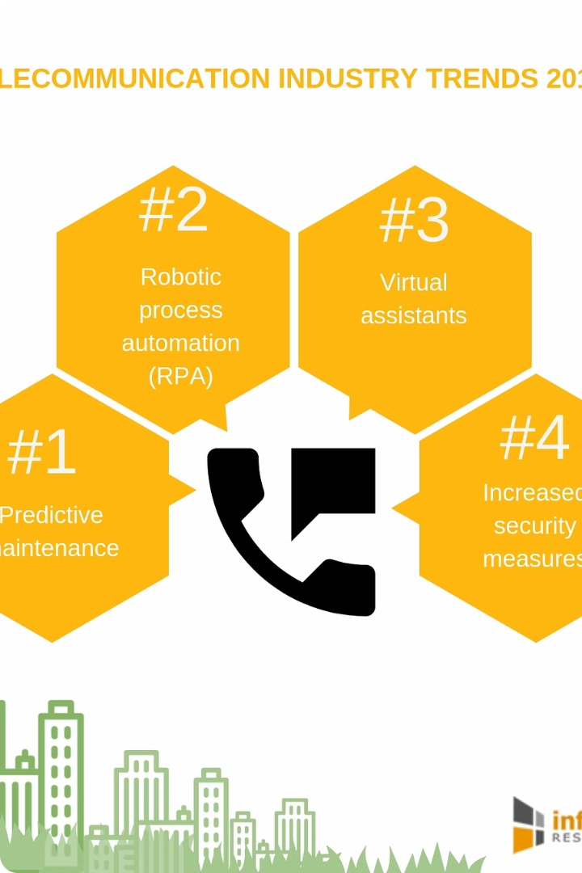
Conclusion
The user overview, engagement, and experience analysis has provided the telecom company with a deep understanding of its customer base and the factors that influence customer satisfaction. By leveraging these insights, the company can make informed decisions, optimize its services, and deliver a superior user experience that meets the evolving needs of its customers.
Key Takeaways
Next Steps
Identified top handsets, manufacturers, and user behavior patterns
Implement targeted marketing campaigns and product offerings based on user insights
Analyzed user engagement metrics and segmented customers based on engagement and experience
Optimize network performance and device compatibility to enhance the customer experience
Developed a predictive model to monitor and improve customer satisfaction
Continuously monitor and refine the predictive model to drive ongoing improvements in customer satisfaction

Slide 28



Model Deployment Tracking
To ensure the ongoing effectiveness of the predictive model developed for customer satisfaction, it is crucial to implement a robust model deployment and tracking process. This will enable the telecom company to monitor the model's performance, identify any changes or drift, and make necessary adjustments to maintain its accuracy and relevance.
Model Versioning
Performance Monitoring
Artifact Tracking
Track the code version, source, and parameters of the predictive model to ensure traceability and facilitate future updates.
Maintain a record of the model's output files, including any visualizations or reports, to provide a comprehensive audit trail.
Continuously monitor the model's metrics, such as loss convergence and accuracy, to identify any degradation in performance.

Slide 29
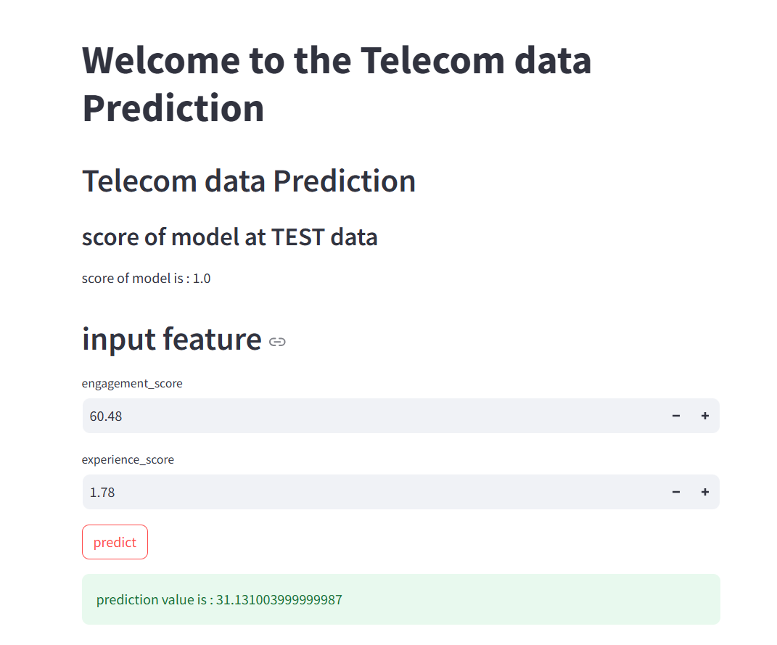

Slide 30



Thank You
Thank you for your time and attention. We welcome any questions or feedback you may have.
Email
Phone
Website
contact@company.com
+1 (555) 555-5555
www.company.com

